Slide 1
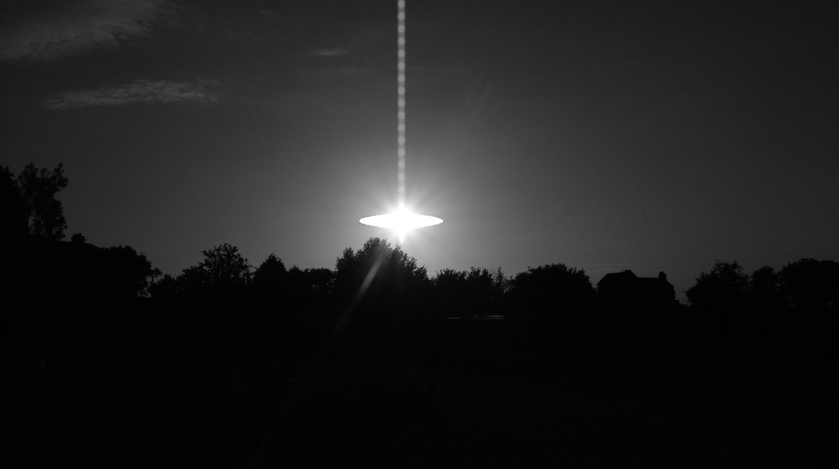
TEAM
RESPONSIBILITIES
Christiane de Caula
Anna Alvarez
Christine Mitchell
Cindy Pappas
API Call & Flask
Dashboard (HTML/CSS/JS)
Flask/SQLAlchemy
Data Munging & SQL
Topic: UFO sightings in 2018 across the Continental USA
Do dates, region, or other influences effect the number or type of sightings?
Do sightings differ by state?

Slide 2

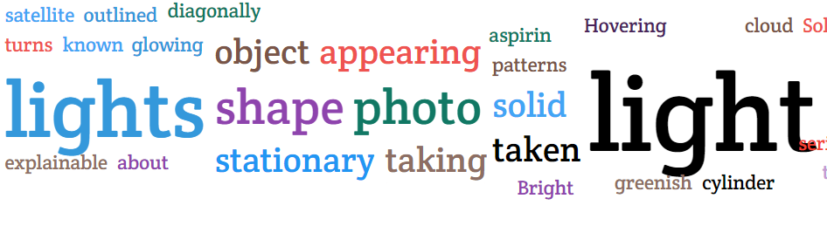
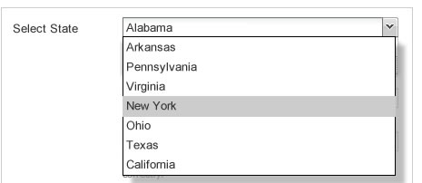
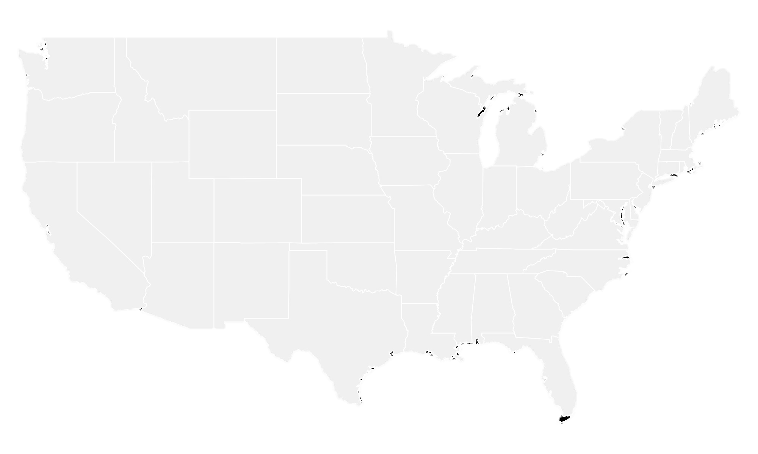
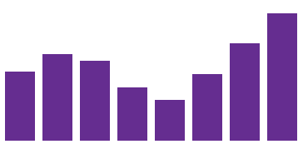


INTERGALACTIC
INTERACTIVE
DASHBOARD
1
Word Cloud
2
Heat Map
User-driven drop down menu
3
GitHub Repo: https://github.com/cynderino/FRL_Project2.git
Datasets Used:
MUFON - https://www.mufon.com/track-ufos.html (data queries pulled into a csv)
Simplemaps - https://simplemaps.com/data/us-cities (csv)
Military Bases (API) - https://public.opendatasoft.com/explore/dataset/military-bases/table/
Bar Chart

Slide 3
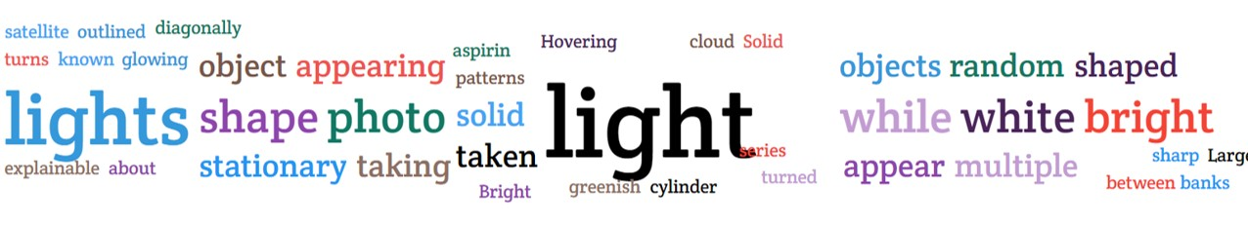
WORD CLOUD
JS Library: JavaScript Wordclouds | ZingChart
Dataset: https://www.mufon.com/track-ufos.html
2018 UFO Sighting Reports (3252)

Slide 4
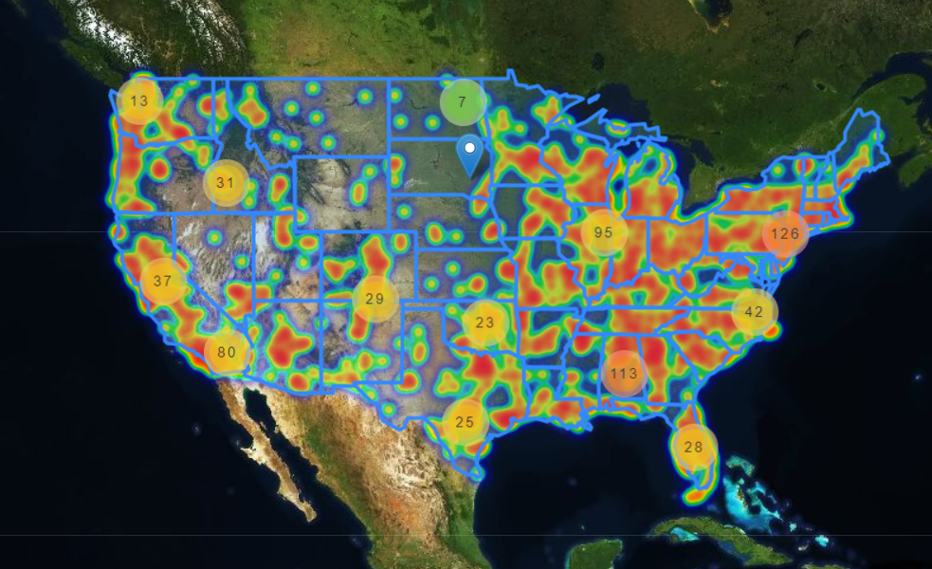
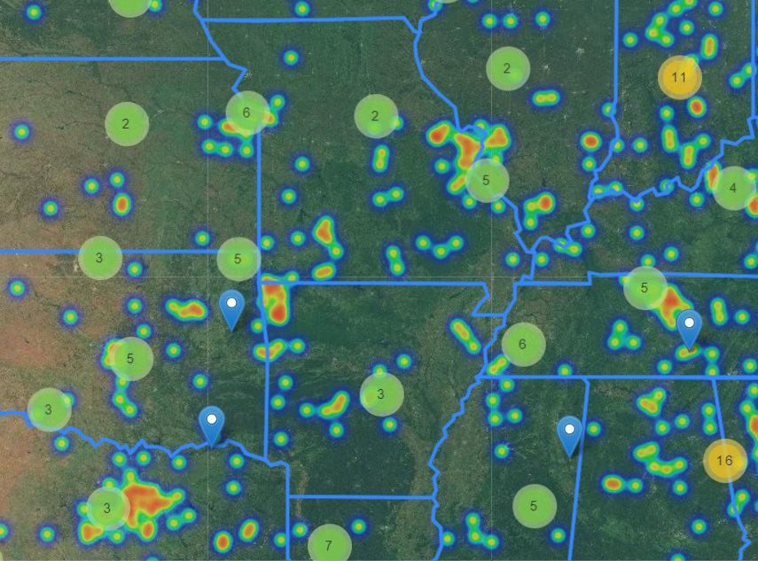
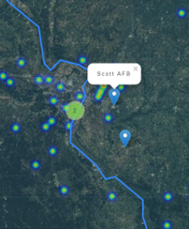
SCOTT AFB
HEAT MAP
Clusters: UFO Sightings
Pinpoints: Military Bases

Slide 5
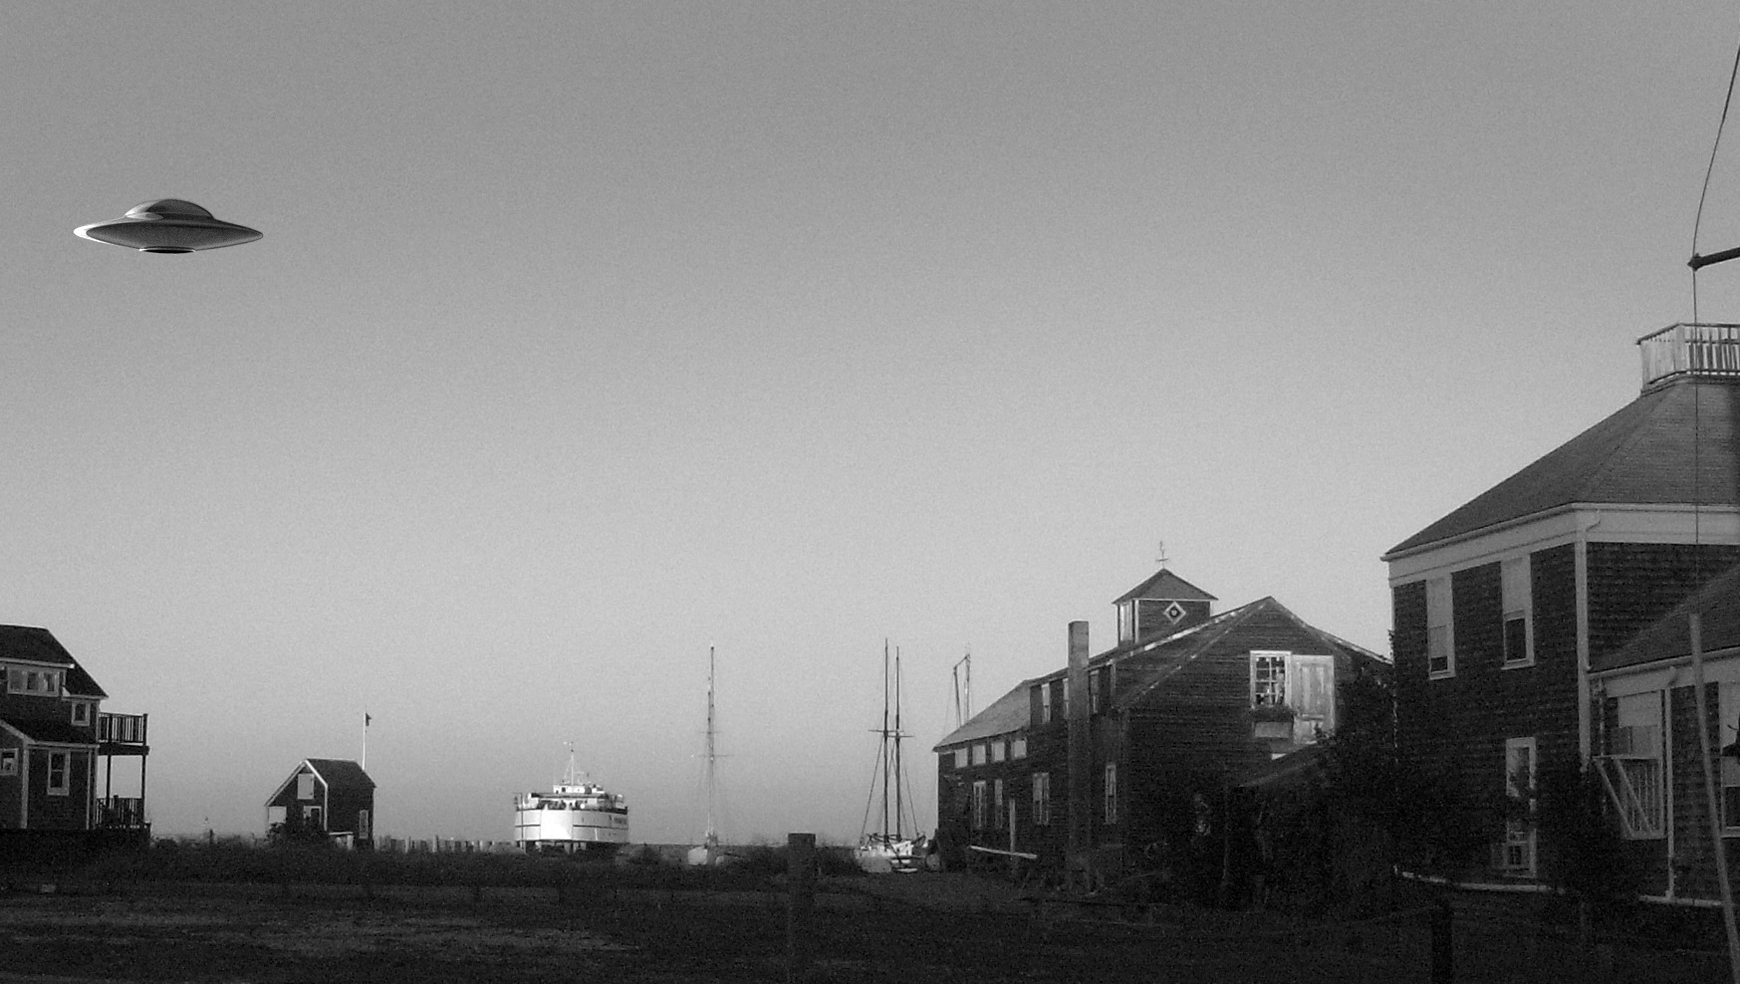
per
UFO
Sightings
month
#
of
BAR CHART
Dataset: https://www.mufon.com/track-ufos.html
2018 UFO Sighting Reports (3252)

Slide 6
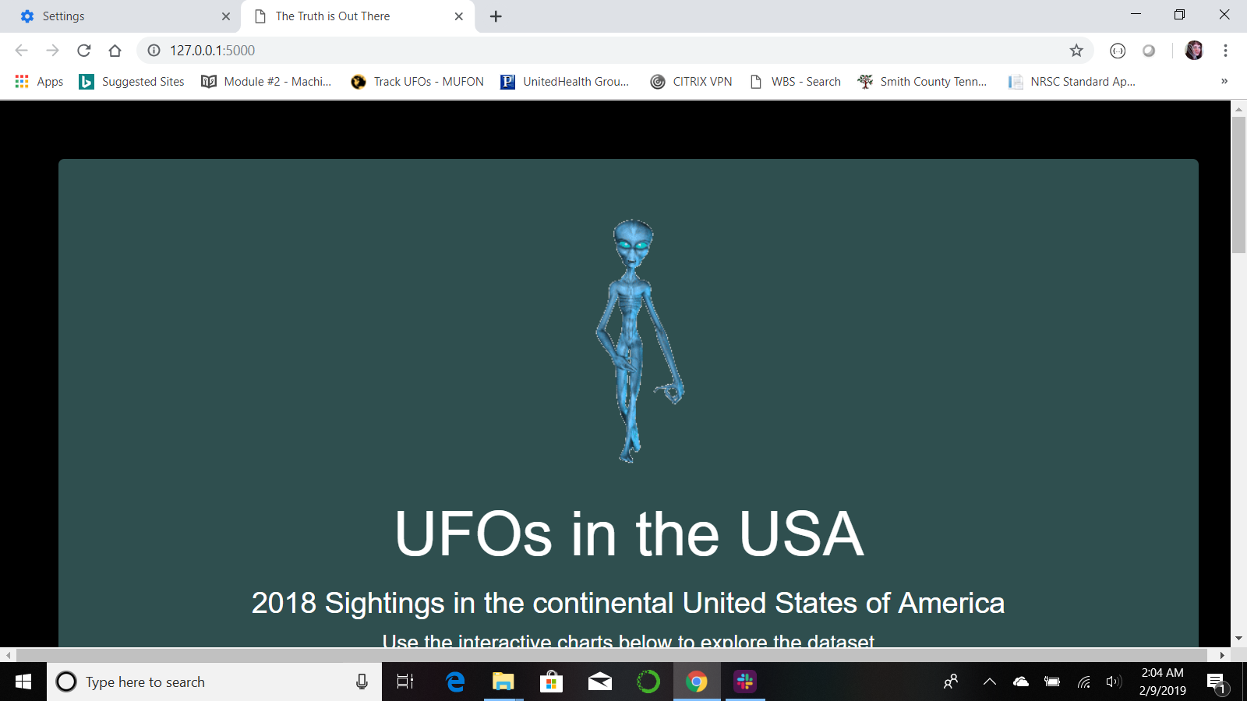
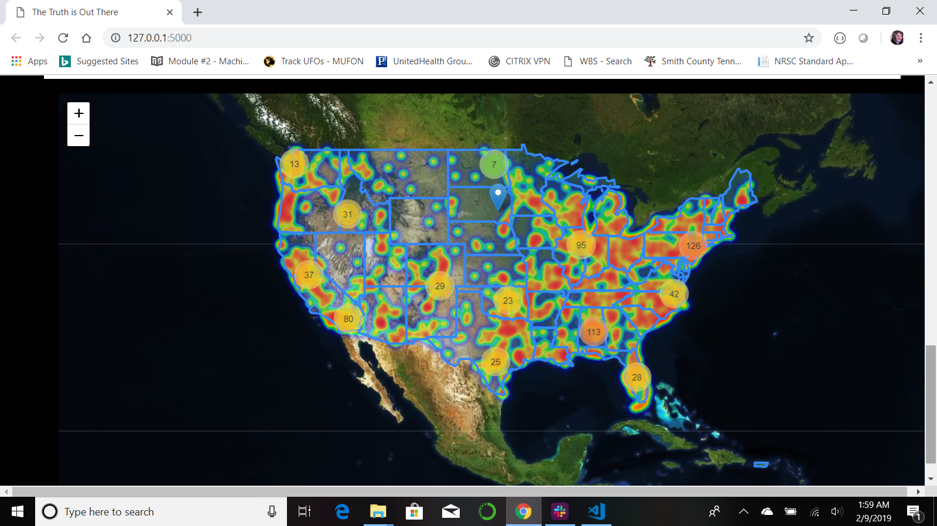
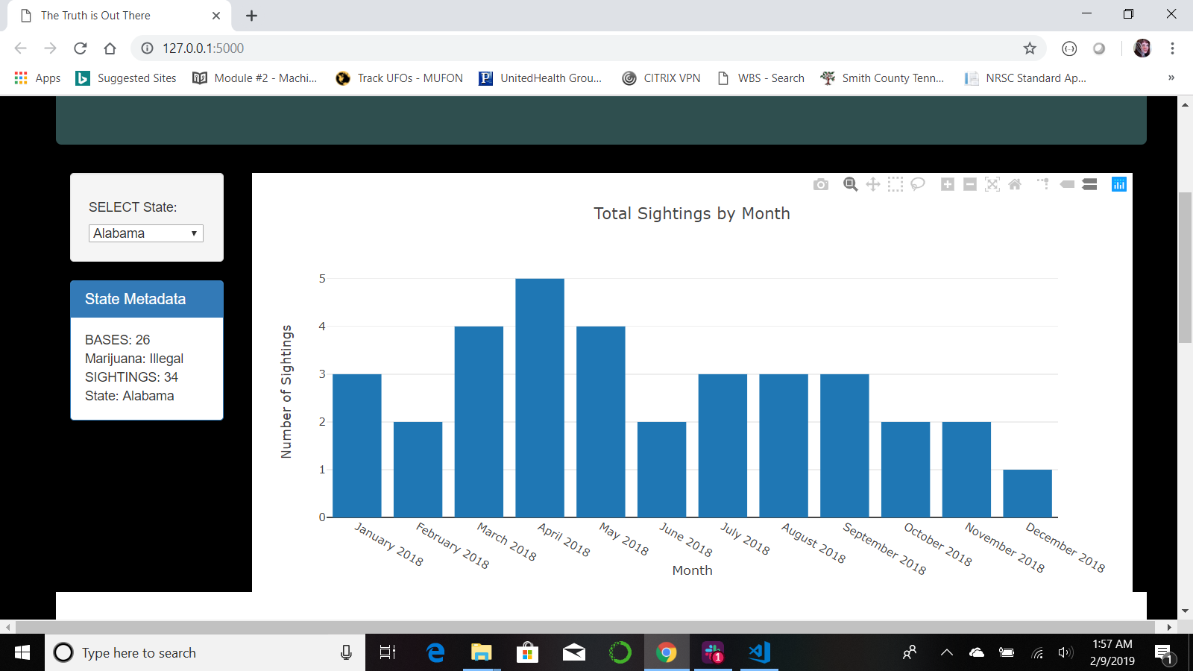
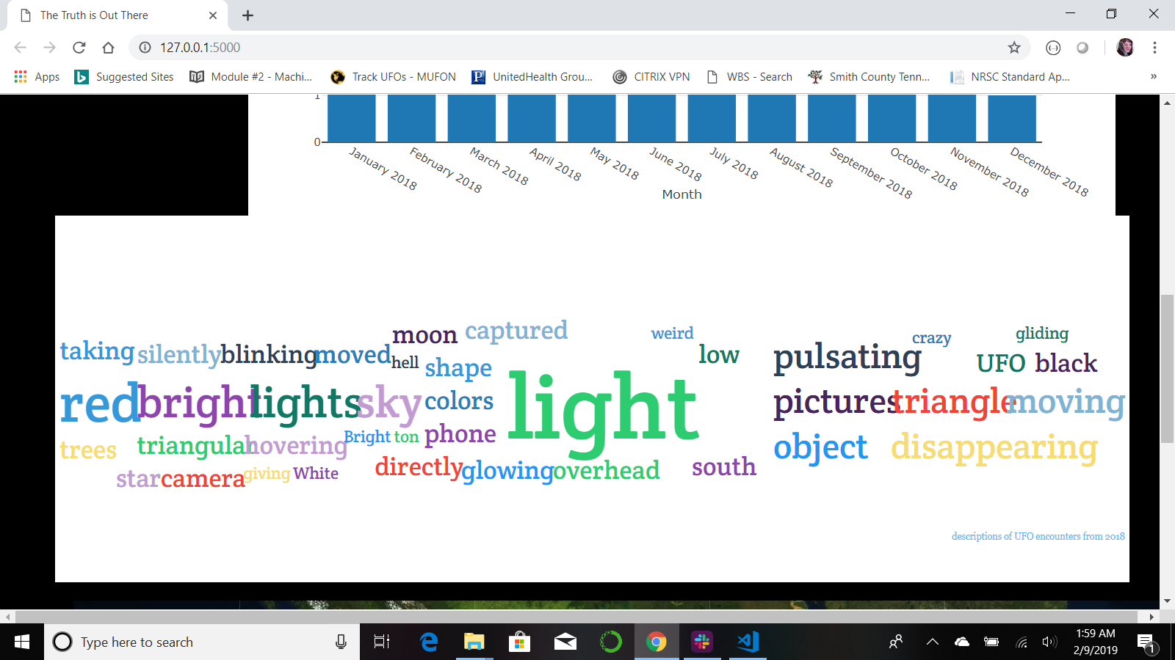
SCREENSHOTS OF ACTUAL PRODUCT

Slide 7

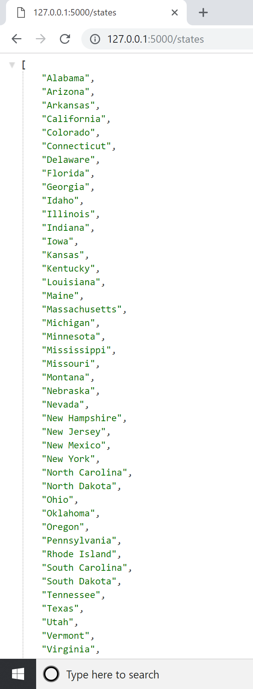
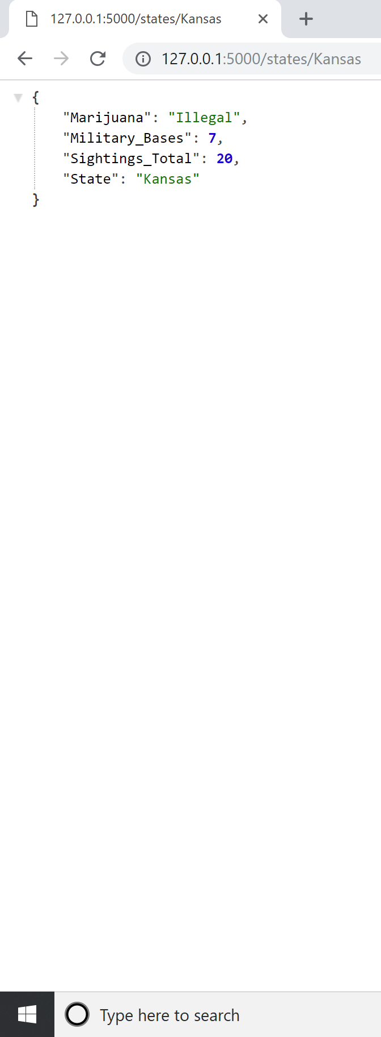
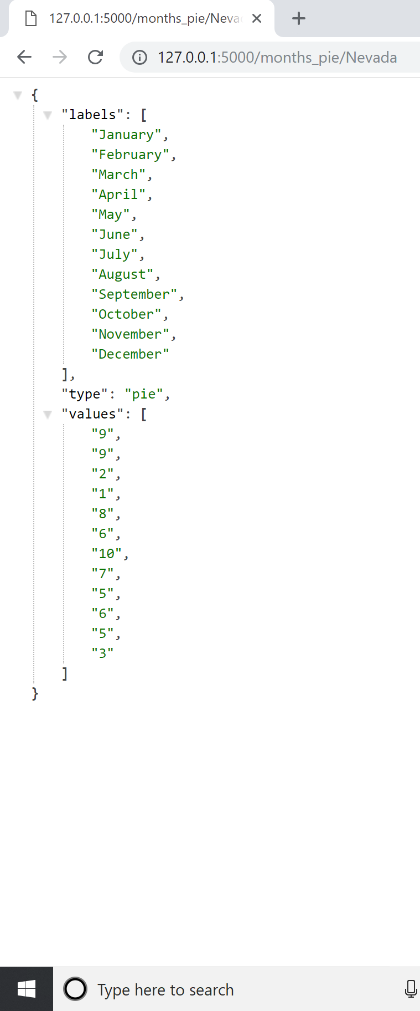
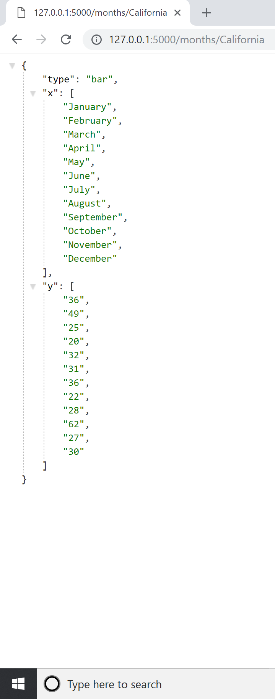
SCREENSHOTS OF ACTUAL PRODUCT

